Slide 1
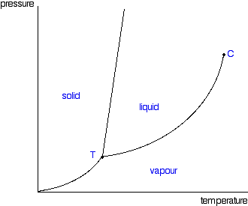
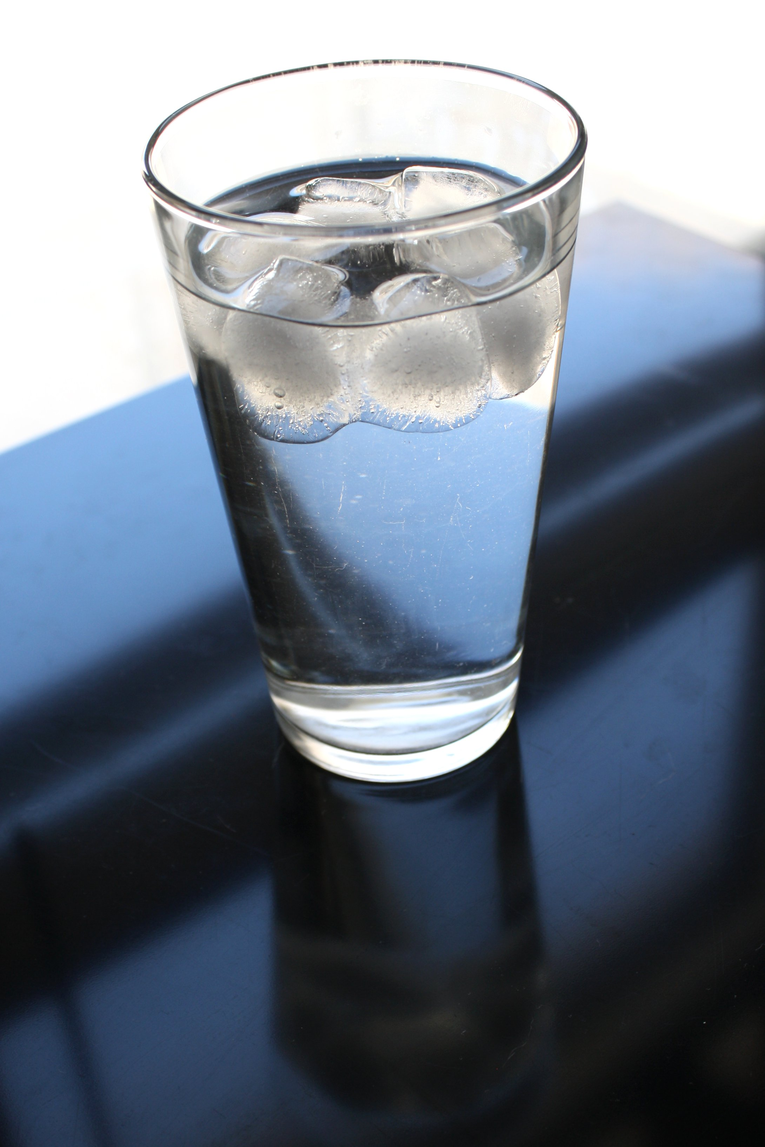


Melting as an endothermic process
P
Melting is an endothermic process.
Endothermic processes draw heat out of the surroundings.
-> Adding salt to an ice-water mixture drives the temperature down.
$${P_{H_{2}O}=P}_{H_{2}O}^{∗}χ_{H_{2}O}$$
T
$T=0 ℃$was in equilibrium
After we added salt, the system found itself warmer than its (new) melting temperature. So some of the ice melted.

Slide 2
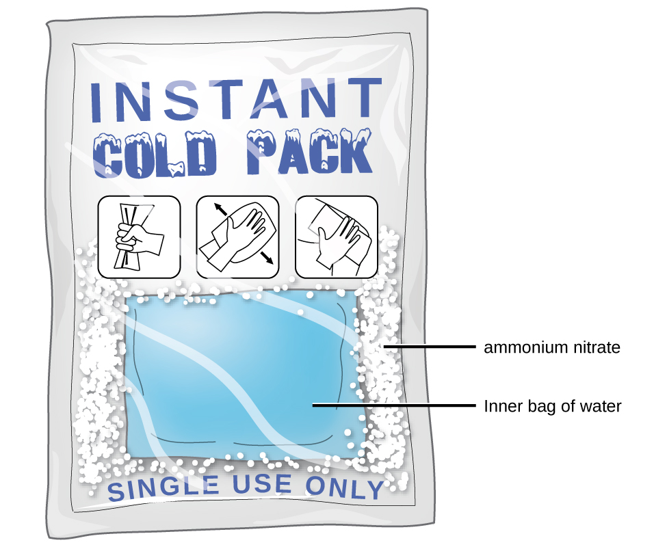
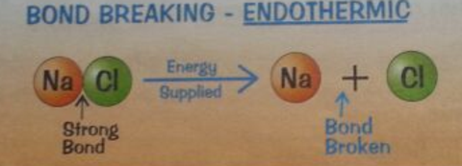
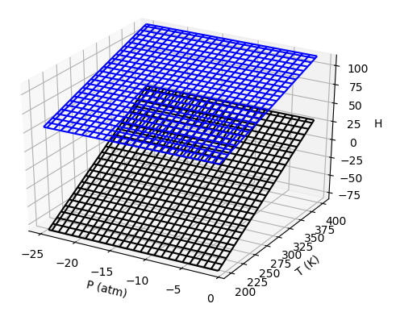
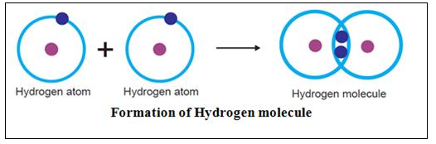
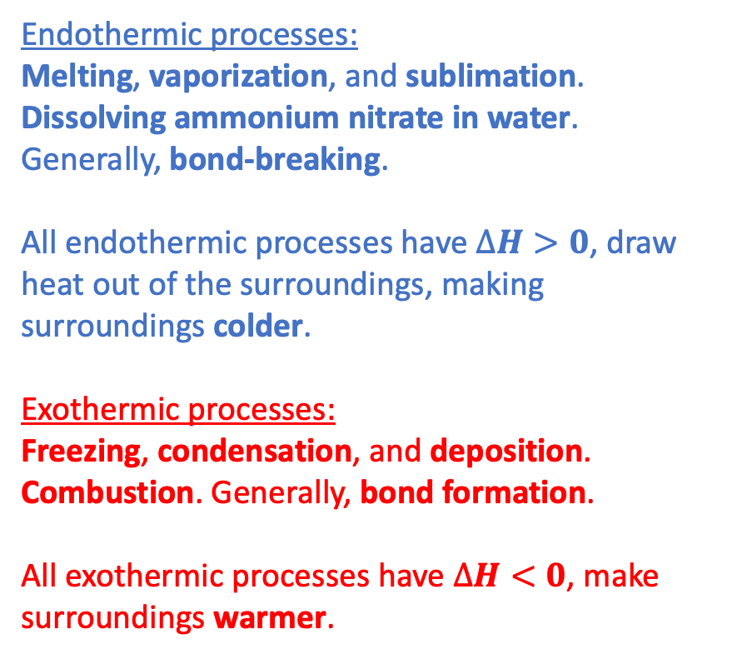
Endothermic and exothermic more generally
Endothermic processes:
Melting, vaporization, and sublimation. Dissolving ammonium nitrate in water. Generally, bond-breaking.
All endothermic processes have $∆H>0$, draw heat out of the surroundings, making surroundings colder.
Exothermic processes:
Freezing, condensation, and deposition. Combustion. Generally, bond formation.
All exothermic processes have $∆H<0$, make surroundings warmer.

Slide 3
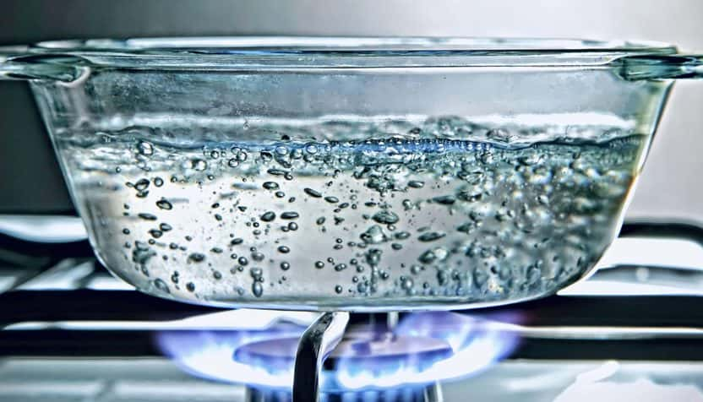
Boiling
P
Atmospheric pressure
Boiling happens when the vapor pressure of bubbles equals (or exceeds) atmospheric pressure.
T

Slide 4
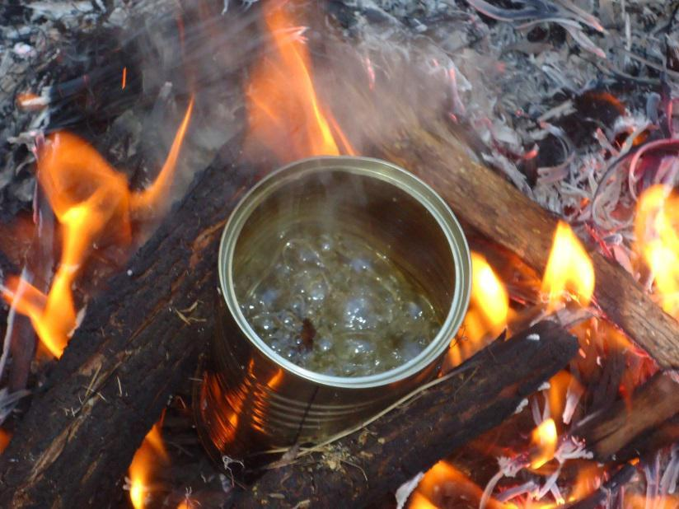
Boiling on Mt. Rainier
P
Atmospheric pressure
On Mt. Rainier
Boiling happens at a lower temperature on Mt. Rainier because atmospheric pressure is lower there.
T

Slide 5


How Raoult explains boiling point elevation
P
$$P_{H_{2}O}^{∗}$$
Standard atmospheric pressure
NaCl
$$P_{H_{2}O}^{∗}χ_{H_{2}O}$$
T
If you add salt to boiling water, it’ll stop boiling (for a moment, anyway) because ${P_{H_{2}O}^{∗}χ_{H_{2}O}<P}_{H_{2}O}^{∗}$.
With the burner on, the temperature will go up until $P_{H_{2}O}^{∗}χ_{H_{2}O}$ reaches atmospheric pressure again.

Slide 6
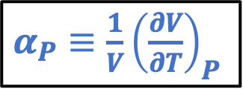
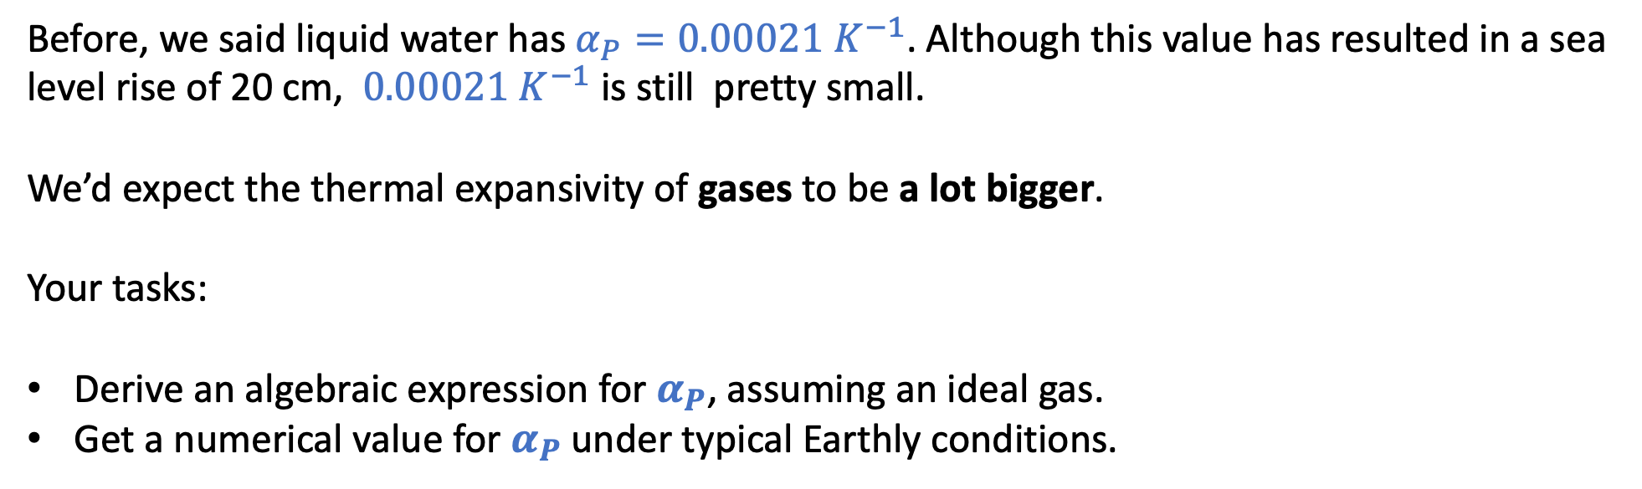
1. Isobaric thermal expansivity of an ideal gas
$α_{P}≡\frac{1}{V}{\left(\frac{∂V}{∂T}\right)}_{P}$
Before, we said liquid water has $α_{P}=0.00021{ K}^{−1}$. Although this value has resulted in a sea level rise of 20 cm, $0.00021{ K}^{−1}$ is still pretty small.
We’d expect the thermal expansivity of gases to be a lot bigger.
Your tasks:
Derive an algebraic expression for $α_{P}$, assuming an ideal gas.
Get a numerical value for $α_{P}$ under typical Earthly conditions.

Slide 7
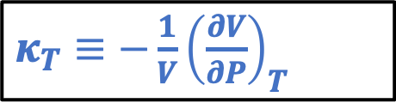
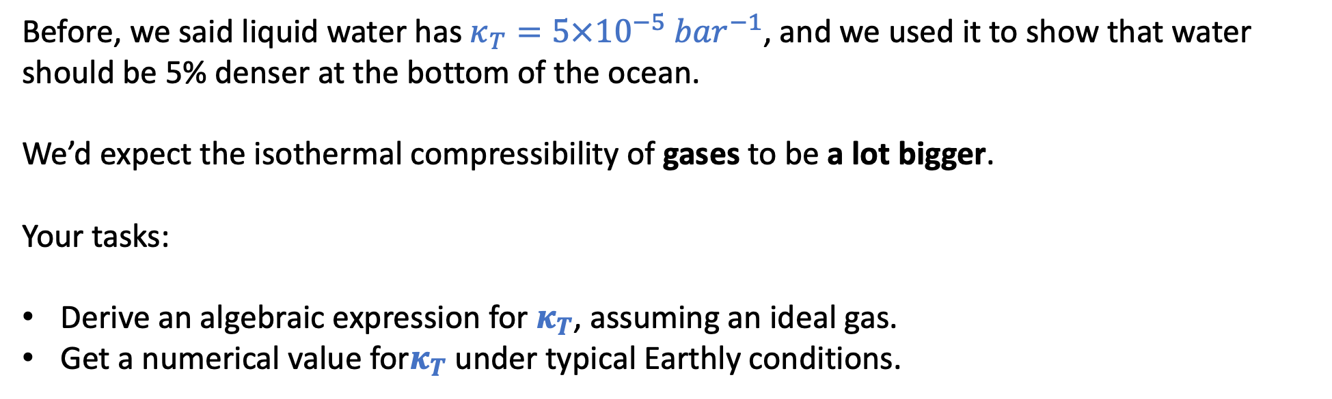
2. Isothermal compressibility of an ideal gas
$κ_{T}≡−\frac{1}{V}{\left(\frac{∂V}{∂P}\right)}_{T}$
Before, we said liquid water has $κ_{T}=5×10^{−5}{ bar}^{−1}$, and we used it to show that water should be 5% denser at the bottom of the ocean.
We’d expect the isothermal compressibility of gases to be a lot bigger.
Your tasks:
Derive an algebraic expression for $κ_{T}$, assuming an ideal gas.
Get a numerical value for$κ_{T}$ under typical Earthly conditions.

Slide 8
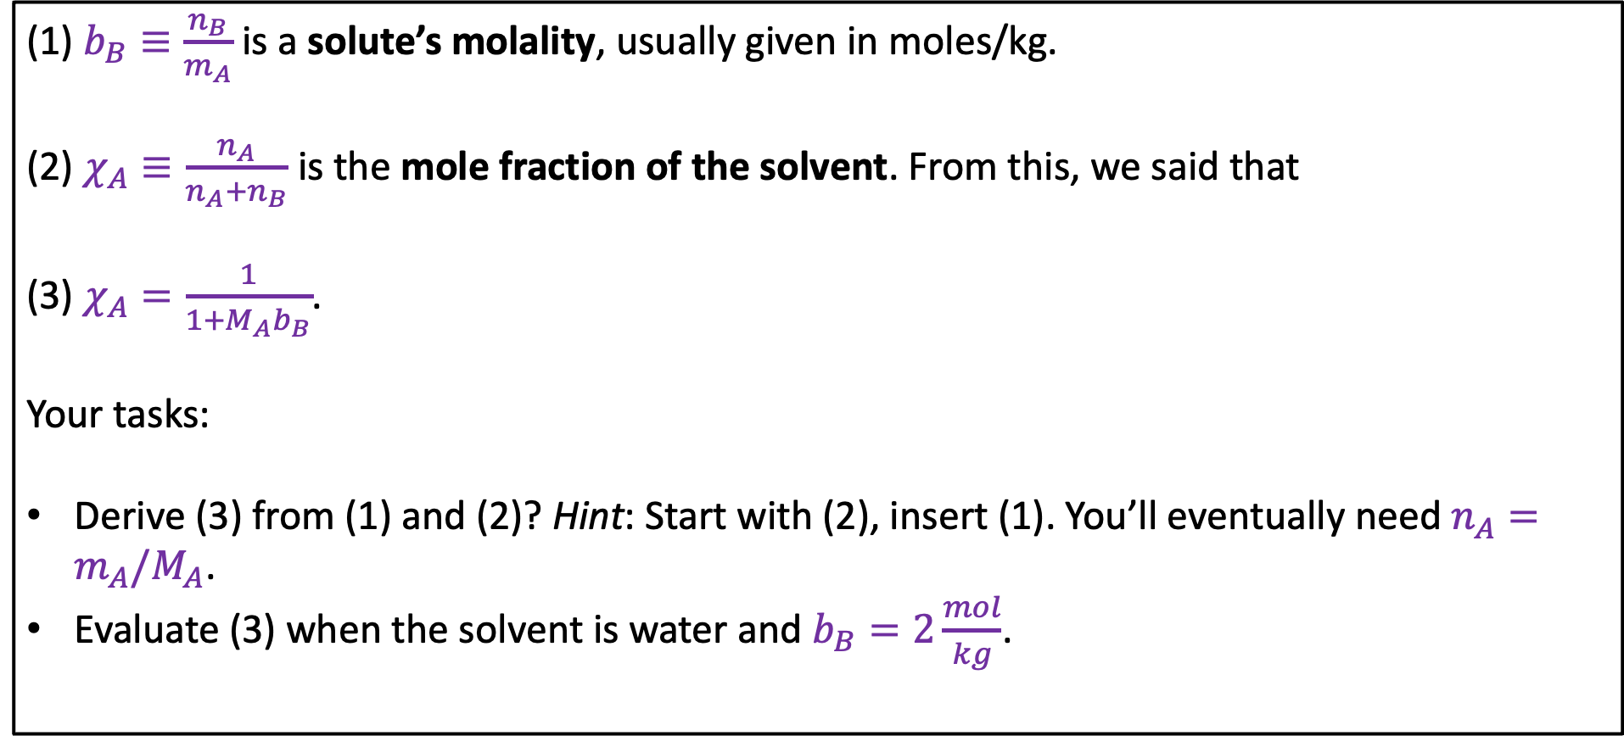
3. Molality and mole fraction
(1) $b_{B}≡\frac{n_{B}}{m_{A}}$ is a solute’s molality, usually given in moles/kg.
(2) $χ_{A}≡\frac{n_{A}}{n_{A}+n_{B}}$ is the mole fraction of the solvent. From this, we said that
(3) $χ_{A}=\frac{1}{1+M_{A}b_{B}}$.
Your tasks:
Derive (3) from (1) and (2)? Hint: Start with (2), insert (1). You’ll eventually need $n_{A}=m_{A}/M_{A}$.
Evaluate (3) when the solvent is water and $b_{B}=2\frac{mol}{kg}$.

Slide 9

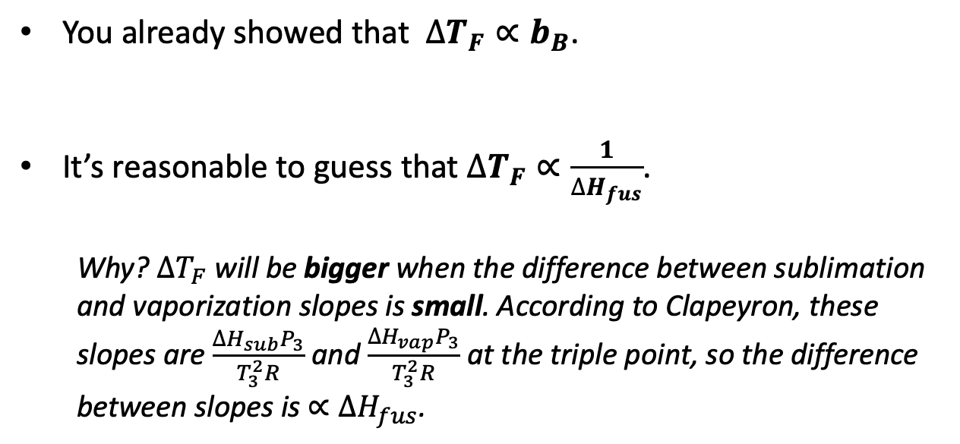
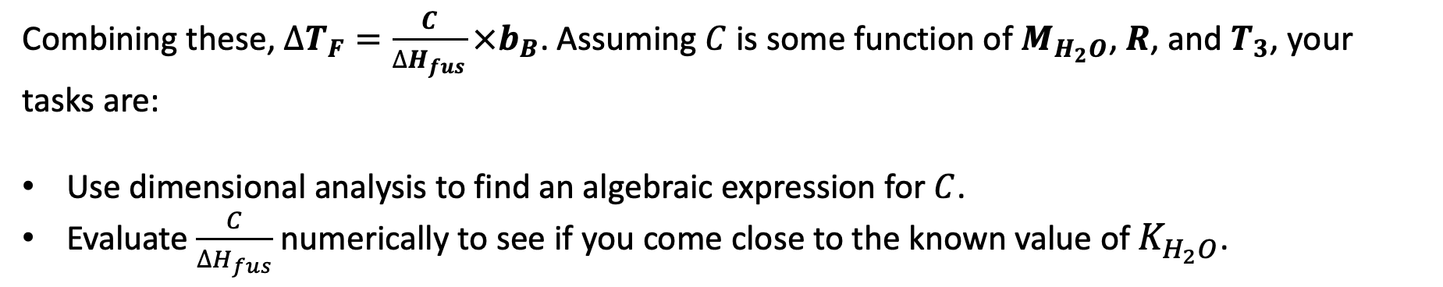

4. Deriving Blagdon’s Law by dimensional analysis
$∆T_{F}$
You already showed that $∆T_{F}∝b_{B}$.
It’s reasonable to guess that $∆T_{F}∝\frac{1}{∆H_{fus}}$.
Why? $∆T_{F}$ will be bigger when the difference between sublimation and vaporization slopes is small. According to Clapeyron, these slopes are $\frac{∆H_{sub}P_{3}}{T_{3}^{2}R}$ and $\frac{∆H_{vap}P_{3}}{T_{3}^{2}R}$ at the triple point, so the difference between slopes is $∝∆H_{fus}$.
P
$$b_{B}$$
T
Combining these, $∆T_{F}=\frac{C}{∆H_{fus}}×b_{B}$. Assuming $C$ is some function of $M_{H_{2}O}$, $R$, and $T_{3}$, your tasks are:
Use dimensional analysis to find an algebraic expression for $C$.
Evaluate $\frac{C}{∆H_{fus}}$ numerically to see if you come close to the known value of $K_{H_{2}O}$.

